Slide 1

Summercroft Primary School PTA
Annual General Meeting (AGM)
17th October 2025

Slide 2
Attendees:
Claire Williams (current Chair), Sarita Thompson (current Treasurer),
Emma Reid (current Vice-Chair), Vicki Scott (current Secretary), Stephen Jess, Emily Richardson, Laura Hunter (new co-Chair), Kathryn Brown (new Secretary), Ben Brodie (new Treasurer), Suzanne Ferdinand, Kristina Gorur, Sahin Gorur, Louise Gordon, Katie Harris, Hannah Lynar, Natalie McCarthy, Patricia Pereira, Andy Scraggs, Deborah Spearman, Jaimee Spencer-Bickle, and Michael Williams.

Slide 3
Agenda
Introduction
Review the previous year
Present the current financial position for the 2024/25 year to 31st August
Approve both sets of accounts for extended year and standard 12-month reporting
Outline plans for 2025/26
Elect a new Board of Trustees
Appoint General Committee members
AOB

Slide 4
What is Summercroft PTA?
A Parent Teacher Association, which is a registered charity entirely run by volunteers
Our aim is to improve the student experience for the pupils of Summercroft Primary School
We do this by:-
  Raising funds for educational resources, play equipment and extracurricular activities
  Strengthening the school community

Slide 5
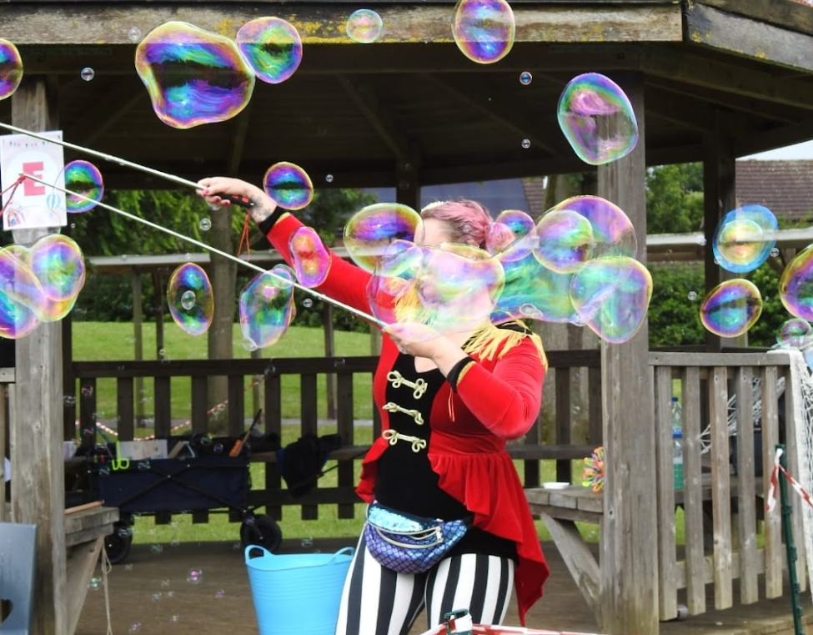
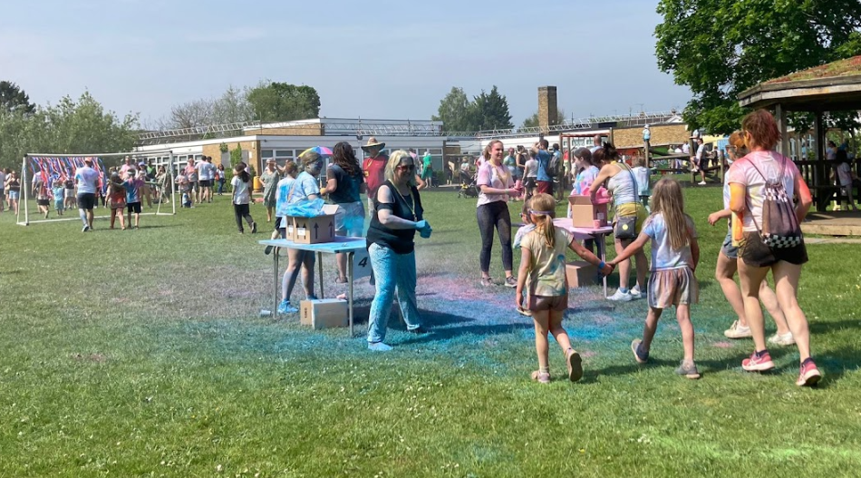
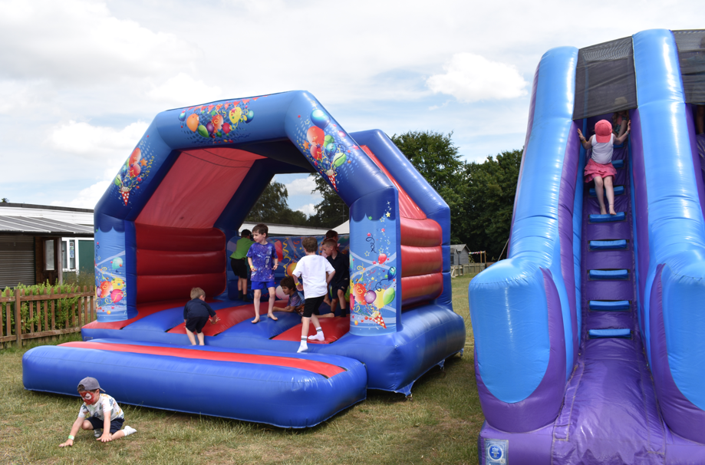
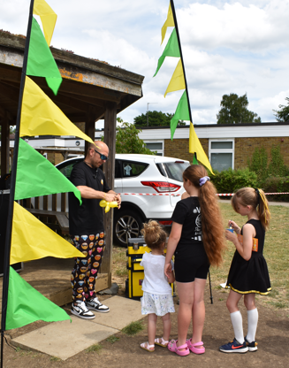
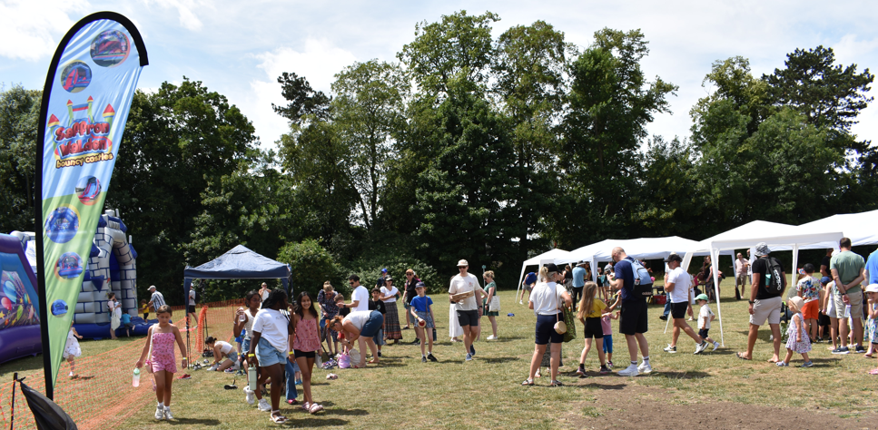
Review of the Previous Year
Events April 2024 – August 2025
Colour Run 2024
Summer Fair 2024
Halloween Disco 2024
Charity Quiz Night 2024
Sponsored Reindeer Run 2024
Break the Rules Day 2025
SummerFest 2025

Slide 6







Review of the Previous Year
Fundraisers April 2024 – August 2025
Tea Towels 2024 and 2025
Christmas Cards and Gifts 2024
Library Book Drive 2025
Termly Preloved Uniform Sales
Grant Applications - Tesco blue token scheme 2024
ASDA Cashpot
Matched Funding Scheme
Easy Fundraising Scheme
Stikins Commission

Slide 7
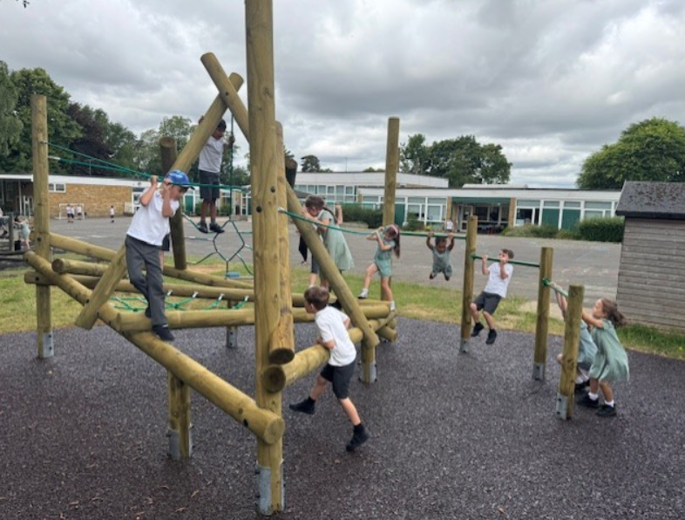
Review of the Previous Year
Grants Awarded April 2024 – August 2025
New Playground equipment and installation
iPads for classrooms
Contribution to Graphic Artwork
History Resources
French Day
Gymnastics Team Kit
Corum Life (ongoing annual commitment)
Year 6 Leaver's books (ongoing annual commitment)

Slide 8
Summary of Accounts
Financial Return will be for the 12-month Period
1st April 2024 – 31st March 2025

Slide 9
Summary of Amounts Raised and Awarded
1st April 2024 – 31st March 2025
Total income = £21,729.84
Total raised after expenditure (including matched funding) = £15,815.52
Total amount awarded to the school = (£3,352.24)

Slide 10
Outgoing PTA Board / Current Members
Chair: Claire Williams
Vice-Chair: Emma Reid
Secretary: Vicki Scott
Treasurer: Sarita Thompson
General Committee Members: Jaimee Spencer-Bickle, Casey Faiers, Hannah Lynar, Stephanie Ricciardi, Deborah Spearman, Wendy Szelong-Cowell

Slide 11
New Board Members
Chair: Wendy Szelong-Cowell & Laura Hunter (Co-Chairs)
Secretary: Kathryn Brown
Treasurer: Ben Brodie
General Committee Members: Stephanie Ricciardi, Jaimee Spencer-Bickle, Hannah Lynar, Deborah Spearman, Casey Faiers
New Committee Members: Nicola McClure, Kristina Gorur and Natalie McCarthy
NB: DBS checks for all new members need to be arranged

Slide 12
Plans for 2025/26
Question for the board candidates: What are your plans / ideas for:
Events
Fundraisers
How to involve the Year 6 PTA Reps
The new board read out statements regarding their plans for the direction of leadership and how to involve the PTA Reps in the year ahead.

